Slide 1


WORLD BANK’S SUPPORT TO UKRAINE
and
Business Opportunities under Projects in UKRAINE
December 17, 2025
Poland
In this presentation, many slides contain hyperlinks. Click on the links to get more information

Slide 2

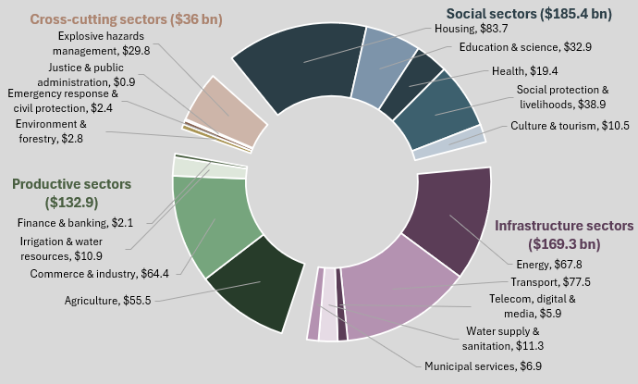
Impact of the war on key sectors: $176bn in direct damage since February 2022 and $524bn in recovery and reconstruction needs
2025 recovery and reconstruction priorities total to $17.3bn
Total recovery and reconstruction needs
Investment projects approved by the Strategic Investment Council: $11.9bn
Non-investment budget programs: $5.4bn
$524bn
Source: RDNA 4 (covers period from February 24, 2022, to December 31, 2024)

Slide 3
Ukraine: World Bank Group Collaboration and Mobilization
The World Bank supports Ukraine, in close collaboration with bilateral and other MDBs, including the IMF and EU, EBRD and EIB.
Since February 2022, the World Bank Group has mobilized about $87.2 billion in financial support to Ukraine, of which nearly $61.4 billion has been disbursed to date (November 30, 2025).
About 97% of this financing was provided by development partners.
For more information , click on the links provided in the underlined phrases

Slide 4




World Bank Active Financing to Ukraine
(Total funding allocated across key sectors)
 | Sector | Total (M)
 | SOCIAL PROTECTION & HUMAN CAPITAL (including) INSPIRE: Strengthening social protection LEARN: Education access & resilience HOPE: Housing repair for displaced persons | $3 482
 | INFRASTRUCTURE & ENERGY (including) Power Transmission & Grid Resilience Transport & Urban Infrastructure | $907
 | ECONOMIC RECOVERY & GOVERNANCE (including) Agriculture Recovery (ARISE) Enterprise Growth & Fiscal Governance | $9 675
 | EMERGENCY & WAR RESPONSE (including) PEACE: Public Expenditures for essential services RELINC: Logistics & network connectivity | $54 383
 | TOTAL | $68 447

Slide 5
Memorandum of Intent (MoI)
The World Bank, EBRD, EIB and CEB are harmonizing procurement practices in Ukraine:
MoI of October 2023 and Implementation Roadmap
Some Key features of Roadmap to implement the MoI
Expanding mutual reliance arrangements and harmonized procurement oversight in jointly co-financed projects;
Expansion of the use of e-Procurement system “Prozorro” for procurement under MDB Portfolios;
Supporting the Government of Ukraine to mitigate risks in tendering and contracting – development of Standard Bidding/Procurement Documents;
Supporting the Government of Ukraine in de-risking the procurement operating environment (Public Procurement Law(PPL) to be aligned to EU Procurement Directives);
Enhance integrity of procurement processes - “Red-flag” system within Prozorro e-procurement system for automatic detection of irregularities;
Capacity development of PIU staff to promote professional procurement;
Enhance effective participation in Public Procurement reducing barriers and enhancing knowledge – Business Outreaches on public tenders to national and international markets.
For more information , click HERE

Slide 6
Specific Procurement Flexibilities
In response to emergency caused by the Russian invasion and subsequent consequences for procurement process, specific procurement flexibilities for Ukraine were approved by Chief Procurement Officer of the Bank in July 2022, and further extended until June 2026.
Key* procurement flexibilities include:
Increased procurement thresholds for market approaches
Reduced bidding/proposal preparation periods
Electronic Bid Submission (through encrypted email)
Standstill Period does not apply
Use of Bid-Securing and Performance Securing declarations instead of regular Bank Guarantees
Slicing large packages into small lots where appropriate
Lowering the qualification requirements relating to turnover and similar experiences, as appropriate
Waiving the advance payment guarantee for advance payments up to 10% and increasing advance payments against the Bank guarantee (normally 40% and even higher for accelerated delivery)
*The above list is not exhaustive and includes those procurement flexibilities that are relevant to bidders.

Slide 7
Major WB-financed Projects in Ukraine with Procurement Activities
Project ID | Project Name | Procurement activities and plans
P171050 | Ukraine Improving Higher Education for Results Project | Procurement of equipment, non-consulting and consulting services to support higher education reform. Procurement plan is available.
P176114 | Improving Power System Resilience for European Power Grid Integration | Procurement of large turbine and generator for Hydropower Plant and procurement of battery energy storage systems (BESS) with solar power plants (PV)
P180245 | Health Enhancement And Lifesaving (HEAL) Ukraine Project | Procurement activities include equipment, development of designs and rehabilitation works for health care facilities.
P180318 | Repairing Essential Logistics Infrastructure & Network Connectivity Project (RELINC) | Procurement of tugs, port vessels and portal cranes for Ukraine Sea Port Agency (USPA); consultancy services for preparation of designs and estimates for road construction for Road Agency
P180332 | Restoration Project of Winterization and Energy Resources (REPOWER) | Procurement of wheeled machinery (truck-mounted aerial platforms, crew carrier trucks, etc)
P181200 | Housing Repair for People's Empowerment Project (HOPE) | Procurement activities will include the development of designs and capital repair of partially damaged Multi-Family Buildings
P504171 | Lifting Education Access and Resilience in times of Need in Ukraine Program (LEARN) | Procurement activities will include the development and supply of learning materials, equipment for the improvement of learning environment, consulting services for the strengthening of institutional capacity, services of independent verification agency and hiring individual consultants to support the secondary education reform
P505616 | Resilient, Inclusive and Sustainable Enterprise Program for Results (RISE) | Multiple consulting services (IT, capacity building focusing on SMEs, etc) to support achievement of results identified under PforR component
P506083 | Transforming Healthcare through Reform and Investments in Efficiency (THRIVE) | Procurement activities will include vehicles, IT equipment and consulting services to support the National Health Service of Ukraine
P506476 | Strengthening Government Capacity for Fiscal Reform Implementation (STRONG) | Multiple consulting services focusing on Public Investment Management system reforms, urban planning, fiscal governance, compliance in revenue administration, stakeholder engagement and policy analysis
P504999 | Delivering Resilient Infrastructure In Vulnerable Environments In Ukraine (DRIVE) | Consulting services for preparation of road construction designs, climate resilience, gender surveys, training, etc and reconstruction and capital repair of M-07 road Kyiv-Kovel-Yahotyn

Slide 8
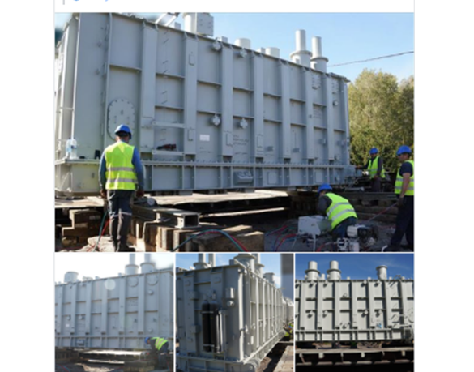
REPOWER: Response to Needs and Results
The Restoration Project of Winterization and Energy Resources (REPOWER): Recovery of the electricity supply and emergency equipment for the heating services.
$123.9 mln of initial $363 mln URTF grant disbursed for procurement
Remaining Funding Gap: US$137 million, but sector needs are larger.
Results:
The project has critically supported restoration of electricity supply for 3-4 million customers and heating supply for 1-2 million customers through delivering critical equipment:
Power transmission equipment
13 autotransformers and 21 transformers delivered while additional 2 transformers to be delivered by end of 2025
Special machineries and trucks are delivered, some additional machineries are in process of manufacturing and supply
level 2 protective shelters are under construction
Heating equipment
Urgent equipment including cogeneration units, boiler houses, frequency converters and pipes are under delivery
Upcoming opportunities:
Procurement of other power and heating equipment are expected in the coming months based on availability of additional funds.

Slide 9
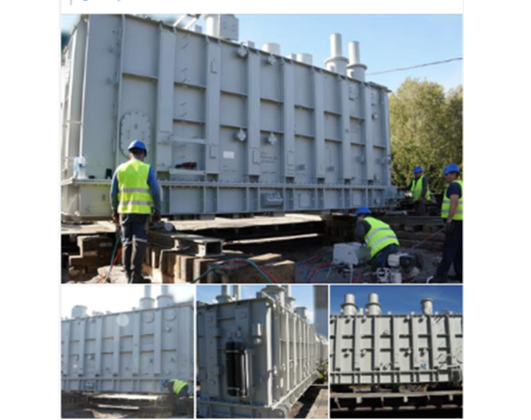

REPOWER: Response to Needs and Results
Re-PoWER delivering equipment; further disbursements expected in 2026
Re-PoWER targets restoration of essential energy services through procuring critical equipment and supporting protective facilities.
Current funding from URTF: US$363 million in committed grants to date, including US$116 million signed at URC this summer covering emergency heating equipment for 7 cities.
Remaining financing gap under REPOWER is US$137 million, but sector needs are larger.
Activities | Committed | Disbursed | Notes
Component 1: Emergency procurement of power transmission equipment & construction of level 2 shelters, partnering with Ministry of Energy and Ukrenergo | US$199.7 M | US$77.2 M | 34 transformers, trucks, cranes and special machineries delivered (and 2 transformers are pending)
Component 2: Emergency procurement of heating equipment, partnering with MDCT, seven cities, and UNOPS | US$163 M | US$46.7 M | RfQ launched in November for 45 cogeneration units (12 lots for 5 cities) & 4 boilers (Kryyvi Rih).
Component 3: Project management and monitoring | US$0.3 M | US$0 M
Total | US$363 M | US$123.9 M (34%)
Upcoming opportunities: Procurement of other power and heating equipment are expected in the coming months based on availability of additional funds.

Slide 10
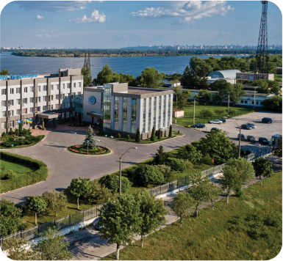
IPSR: Improving Power System Resilience for European Power Grid Integration
IPSR: enhance the flexibility of the Ukrainian power grid through storage investments and market expansion to support synchronization with the EU grid and decarbonization of power sector.
$14.8 mln of $250 mln financing disbursed for procurement of power equipment and consulting services
Additional financing (recently approved: $70mln)
Results:
The project has supported restoration of damaged/destroyed power equipment (transformers) critically needed by Ukraine’ largest hydro power generating company PJSC “Ukrhydroenergo"
Ongoing and future opportunities:
a major procurement of turbine and generator for Dniester hydropower plant reference number UHE-CERC-TG has been completed
procurement of Battery Energy Storage Systems (BESS) including installation planned to be launched in early 2026

Slide 11
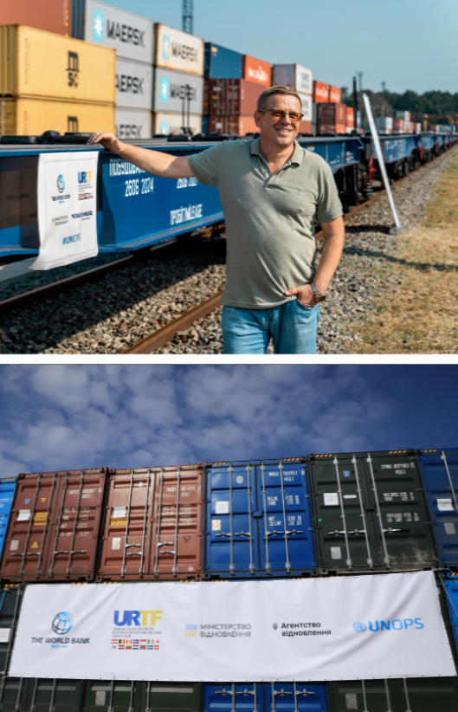
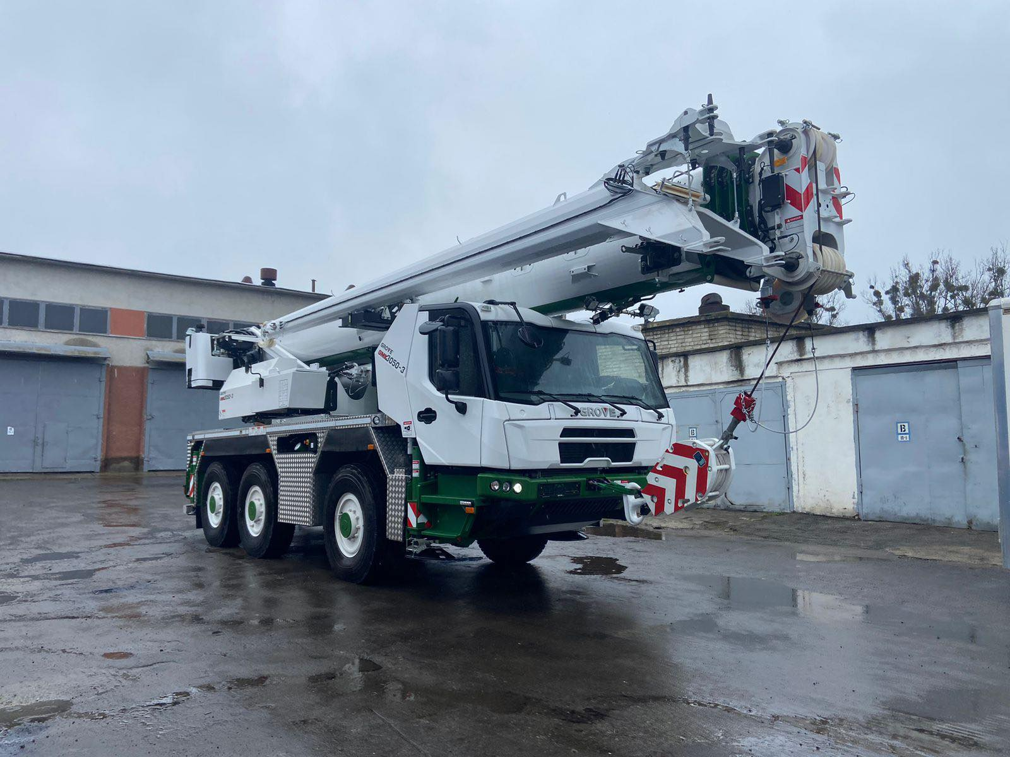

RELINC: Response to Needs and Results
The Repairing Essential Logistics and Network Connectivity (RELINC) Project: Repairs for restoration of critical transport connectivity and provision of rail rolling stock and port handling equipment for enhanced capacity of logistics chains.
Initial URTF grant of $50 mln fully disbursed
Additional URTF grant of $230 mln signed in June 2024
Remaining Funding Gap: $305 million
Results:
Modular road bridges: 18 sets (400 meters) fully delivered
Equipment for rail repairs: fully delivered
Flatbed wagons: 200 wagons fully delivered
25 electric locomotives ($200 mln) – contract signed
Ongoing and future Opportunities:
Danube ports equipment ($35 mln)
  Vessels, handling & lifting equipment (Izmail / Reni ports) and IT system to manage vessel traffic - two tenders for US$11mln in total have been completed, contracts to be signed; 4 new tenders total est. cost around US$22mln to be launched in Sep-25 through Jan-26.

Slide 12
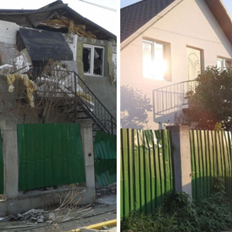
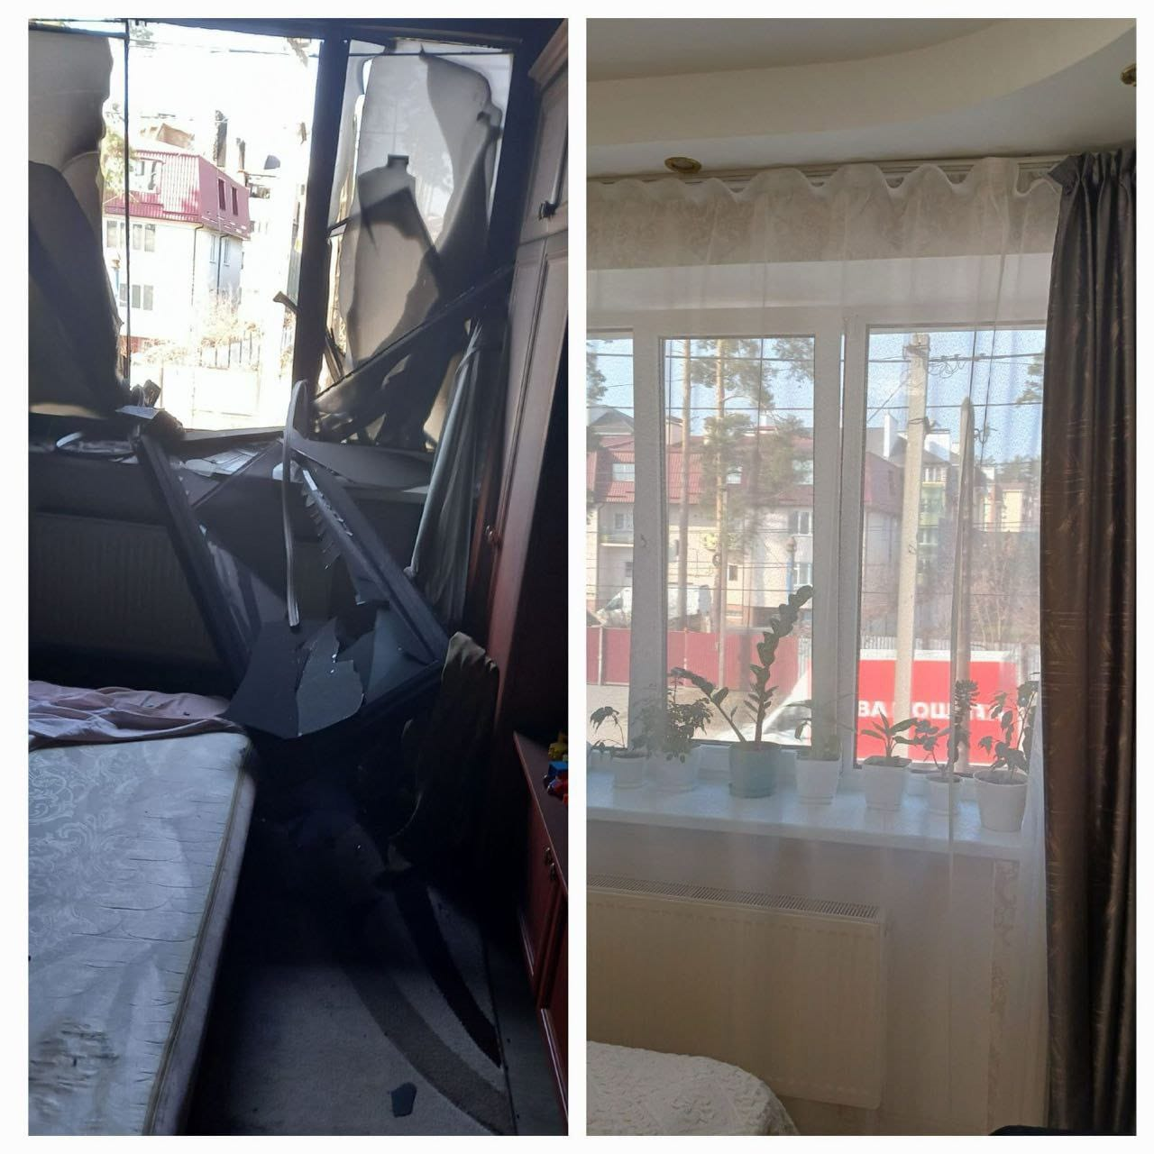
HOPE: Response to Needs and Results
The Housing Repair for People's Empowerment (HOPE) Project: Support critical repair needs of the country’s partially damaged housing stock.
URTF grant of $210 mln fully disbursed for compensations
URTF grant of $12.0 million is allocated for the preparation of designs;
IDA credit of $84 mln disbursed by 48% for compensations
Results:
Over 185,000 applications submitted
Over 120,000 households compensated
Upcoming Opportunities:
Procurement of design packages for 167 multi-family buildings is underway
Launch of procurement of works is anticipated by late Summer, early Fall 2026 (estimated cost $170million)*
* Subject to availability of funds
Before
After
Before
After

Slide 13
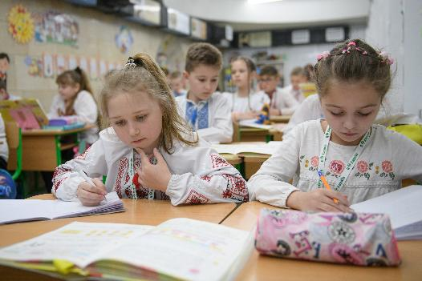
LEARN: Lifting Education Access and Resilience in time of Need
By September 2025, LEARN achieved important
milestones, disbursing $200mn:
Helping restore access to in-person: LEARN provided 18,112 students with access to free transportation.
Improving teaching & learning conditions: 135,059 teachers completed training & 397,570 students received new NUS-aligned textbooks.
Increasing management capacity:
  New NUS roadmap and team in place.
  NUS Reform Pilots (for grades 8 and 9) ongoing
  Management and Information System strengthening
Next steps
Additional financing for Preschool education under preparation.
Dialogue with partners to additional support to teacher development, infrastructure.

Slide 14







HEAL: Health Enhancement and Lifesaving Ukraine Project
KEY RESULTS
6.4M
624K
5.6M
Financing Details:
doses of essential childhood vaccinations provided
to children
people have received
mental health services
people received medications under the reimbursement
“Affordable Medicines Program”
<10.4M
670K
<5,300
$ million
people received
expanded primary health
care examinations
people completed
a course of rehabilitation
services
PHC staff provide care
for survivors of GBV
600
500
Appraised
project cost
400
FINANCING GAP
$167 million (USD)
171
million has been disbursed
300
URTF Base case
URTF
200
Mental health &
Rehabilitation
Primary
Health Care
Hospital modernization
Capacity & Digitalization
CEB
units
Vehicles
(75 electric, 175 diesel)
15
Large-scale civil works in healthcare facilities
(7 PHC centers & outpatient specialized care facilities & 8 hospitals
100
GFF
3 000+
250
1 500+
laptops
IBRD
(Guarantee-Spain)
of rehab
equipment delivered to 194 facilities
200
-
129
PHC solar power stations across 19 regions
units of network
and server IT equipment delivered to healthcare institutions
$ million
100
3
Design & cost documentation stage
KEXIM*
ADDITIONALLY PLANNED
900+
-
60
Mental health
safe spaces
200
PHC solar power stations across
20 regions
5
Additional facilities in pipeline
users
* $100m KEXIM parallel financing does not formally count toward filling the project gap within the Word Bank's systems
with e-Document System implemented
8
Rehab departments

Slide 15
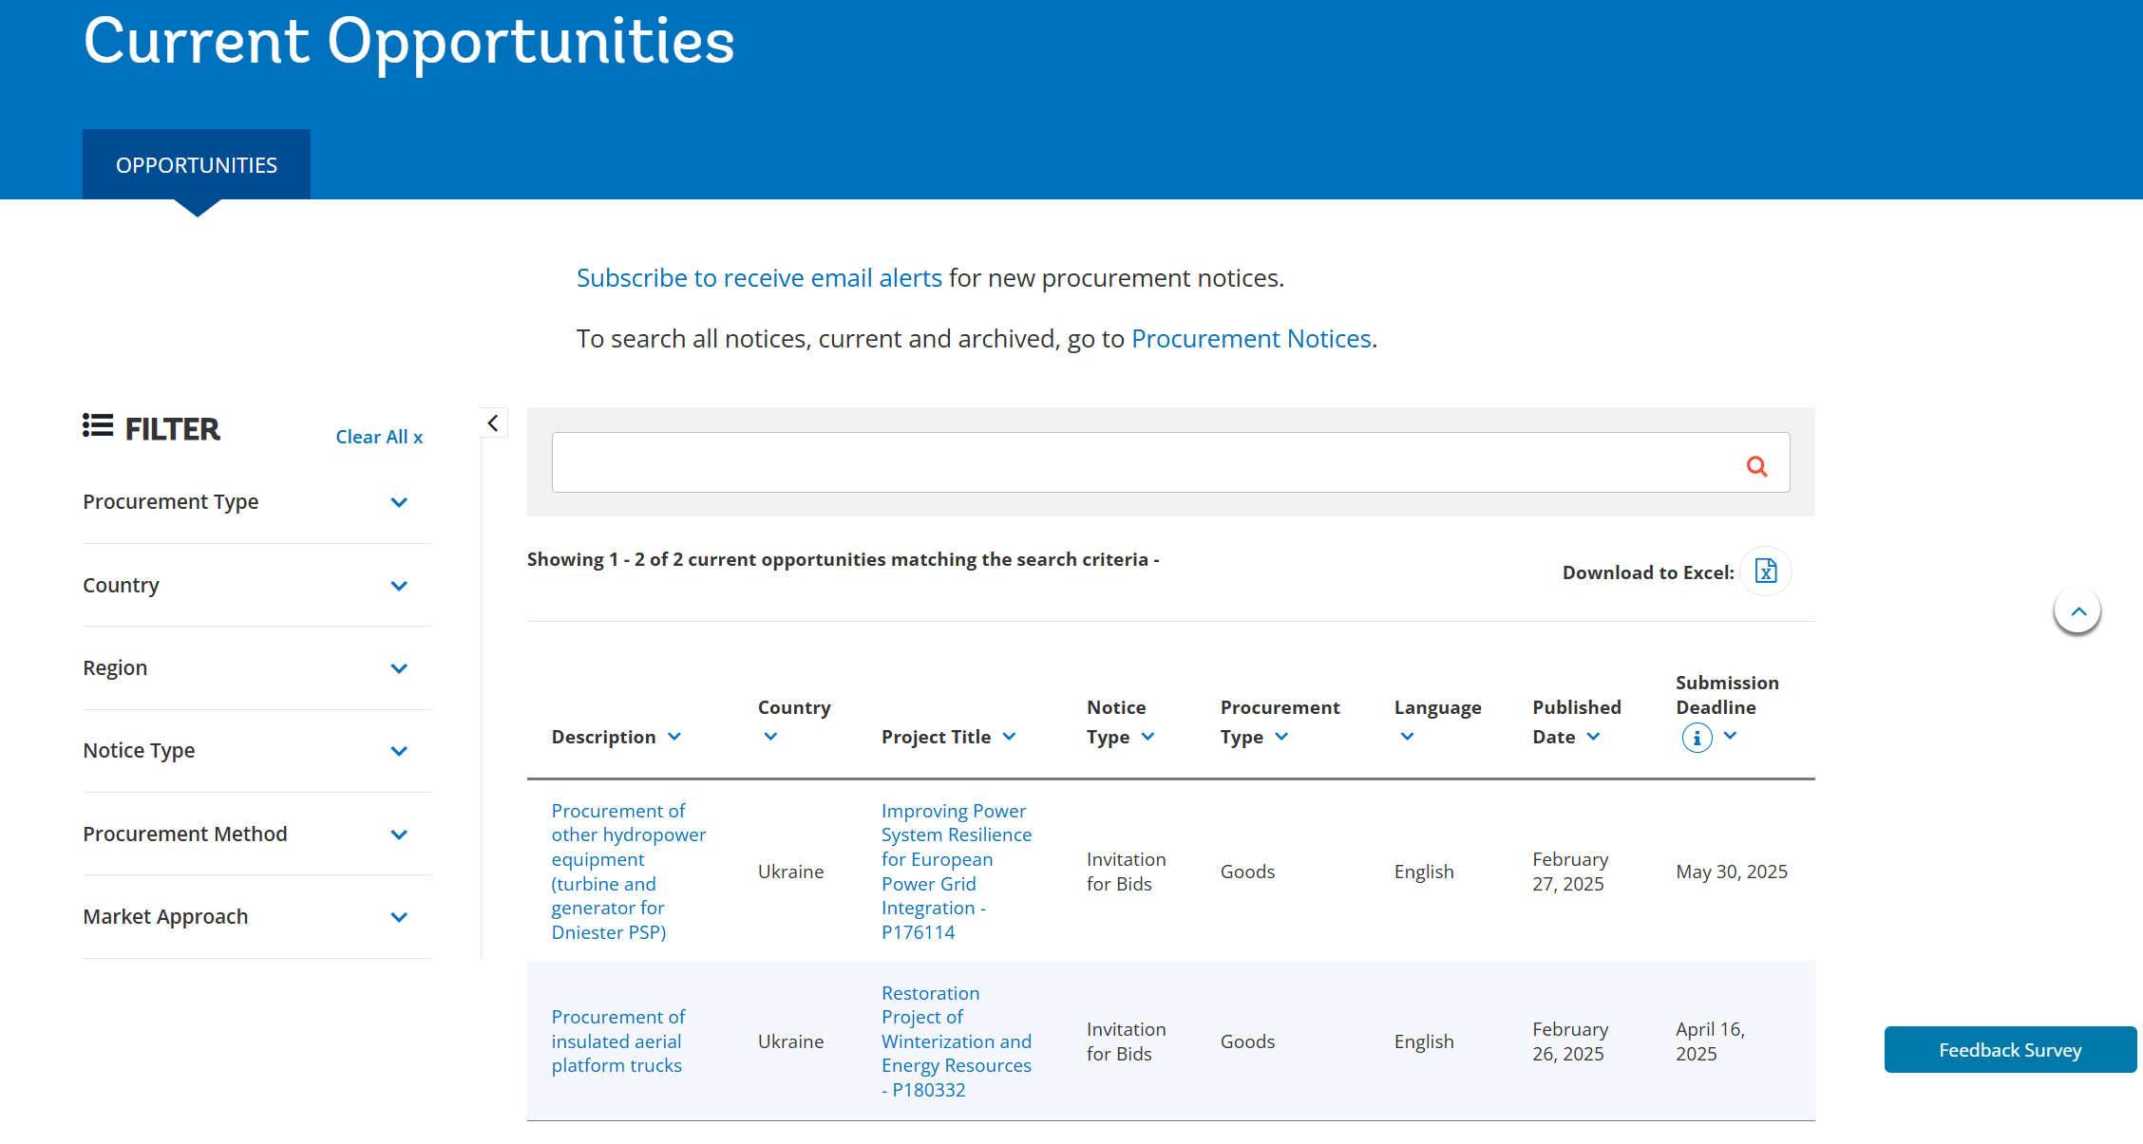
Current Opportunities from WB External Website
https://projects.worldbank.org/en/projects-operations/opportunities

Slide 16
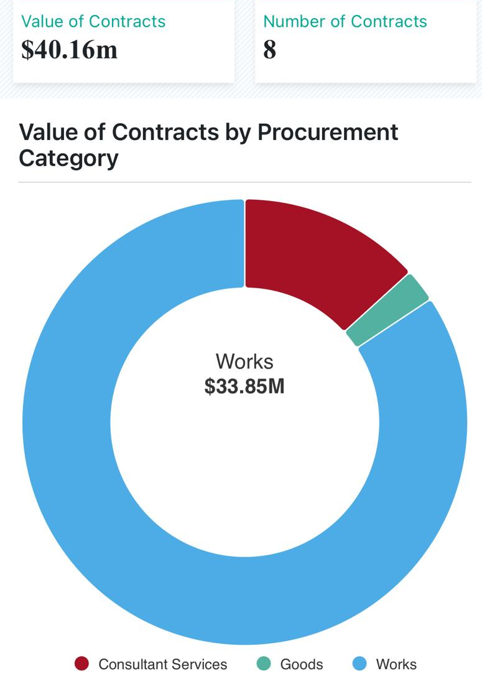
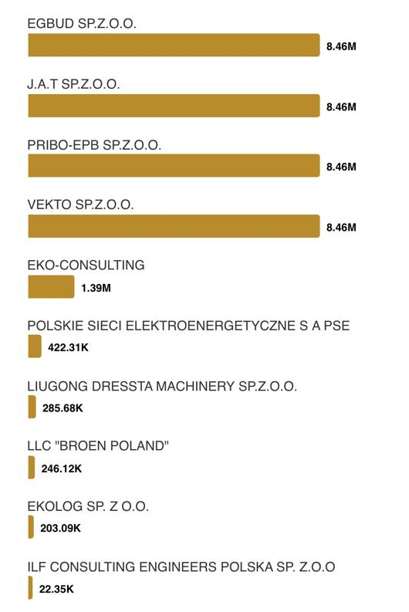
Polish companies were awarded $40.16 million in Ukraine during FY15-25, with 84.3% going to works and 13.2% to consulting services
Contracts were awarded mainly in the water, sanitation and waste management sectors, to the following suppliers:

Slide 17
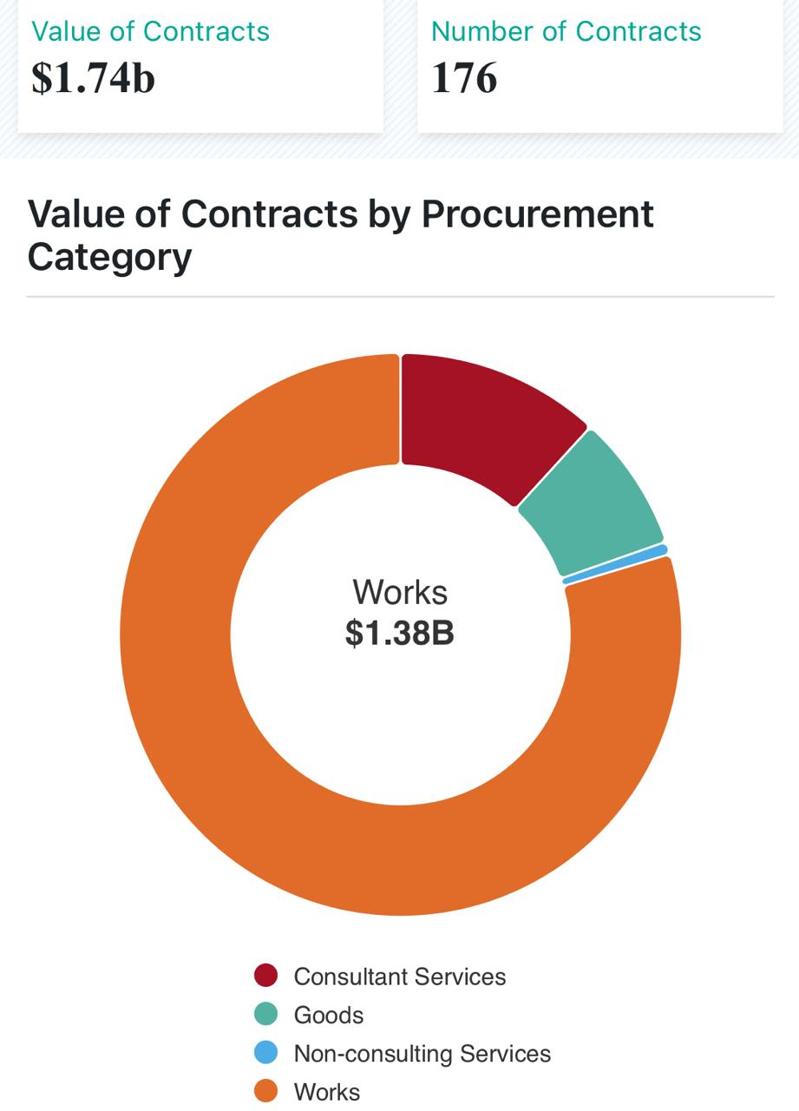
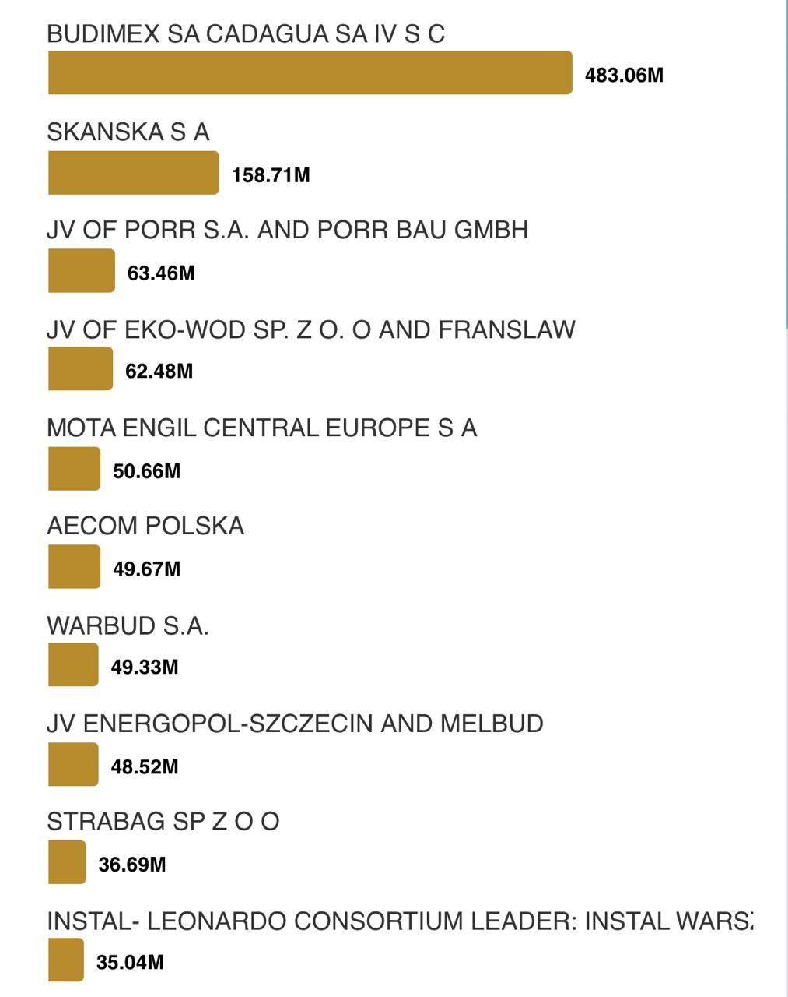
GLOBALLY, during FY15-25 Polish companies were awarded $1.74 billion with 79.3% of the awarded value going to works and 11.8% to consulting services
Polish firms were active in the water, sanitation and waste management, as well as transportation and public administration sectors. The list of top 10 Polish suppliers during the period includes:

Slide 18

Useful Additional Information

Slide 19
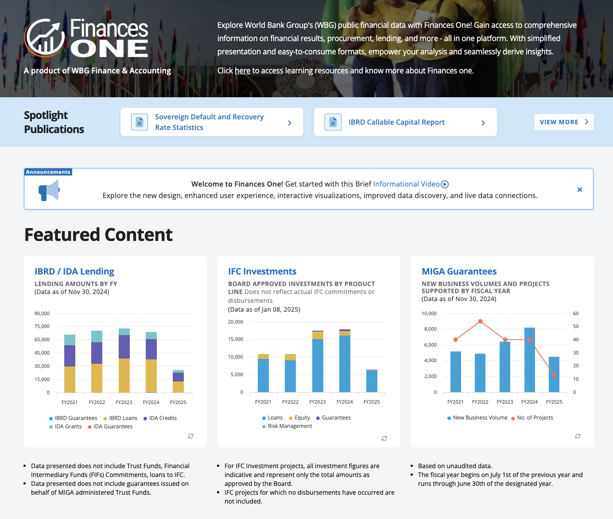
Finances ONE
https://financesone.worldbank.org

Slide 20

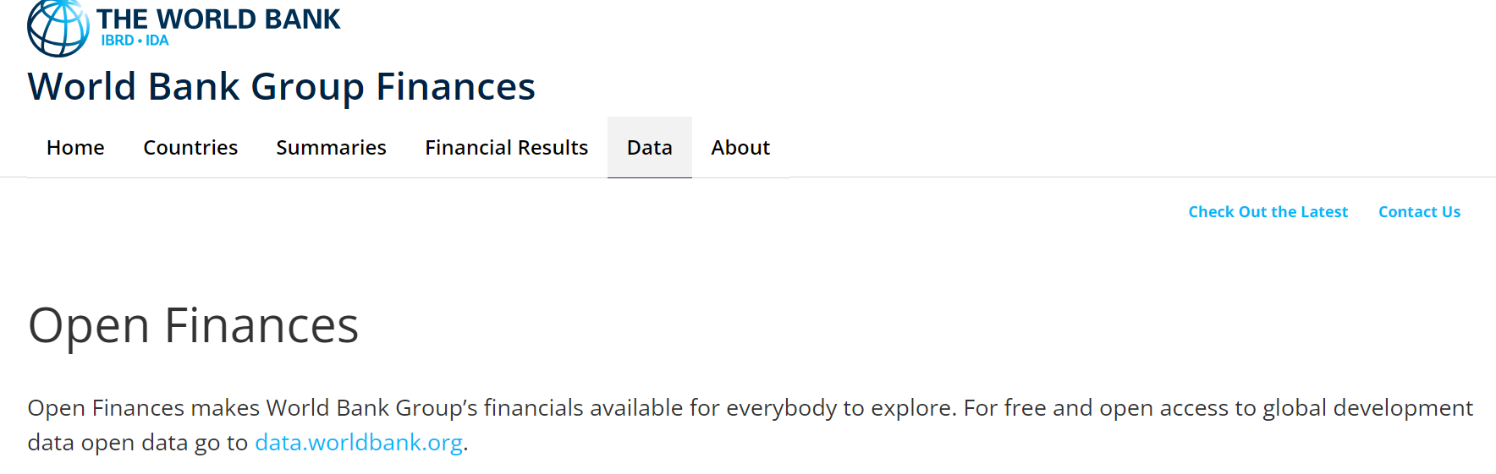
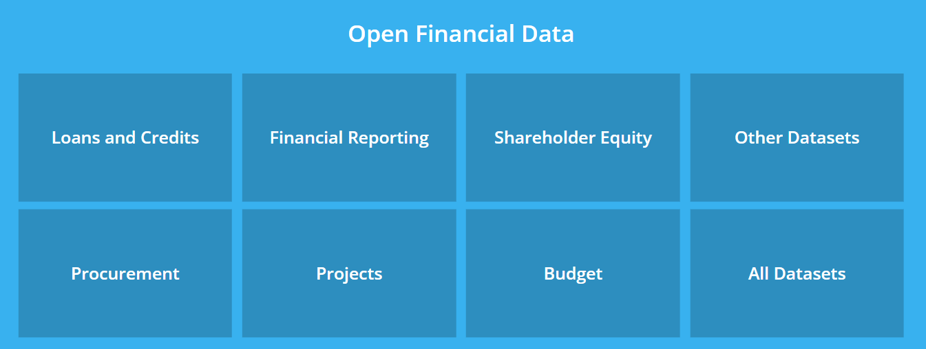
Procurement Guidance
Link
How to Use Finances ONE to Find Contract Data and Opportunities

Slide 21
Thank you for your attention!
Supplier’s Hub:
https://www.worldbank.org/ext/en/what-we-do/project-procurement/for-suppliers

