Slide 1
Information session
Call for Expressions of Interest from EU-based businesses to invest in Ukraine
Leveraging private investments for Ukraine’s recovery
December 17, 2024 Ukraine Service, DG NEAR

Slide 2
Welcome and Opening Remarks 10:00 – 10:20
• Elena Višnar Malinovská, Head of Unit for inter-institutional, coordination of relief and reconstruction, Ukraine Service, DG NEAR, European Commission
• Serhii Tereshko, Deputy Head of Mission of Ukraine to the European Union
• Maryna Khlystun, Director, Investment, Ministry of Economy of Ukraine (online)

Slide 3
Presentation of the Call for Expressions of Interest 10:20 – 10:40
Gabriel Blanc, Team leader for the reconstruction of Ukraine, Ukraine Service, DG NEAR, European Commission

Slide 4
Call for Expression of Interest - Objectives
To support the implementation of the Ukraine Investment Framework, optimal use of the available funds for priority projects and the participation of EU* companies
To enter into dialogue with EU private companies on concrete investment opportunities and related constraints in Ukraine.
To potentially facilitate contact with partner Financial Institutions implementing the Ukraine Investment Farmwork.
To build a pipeline of transformative private investments in Ukraine.
* This Call for Expressions of Interest is open to companies established in the European Union (EU) and the European Economic Area (EEA).

Slide 5
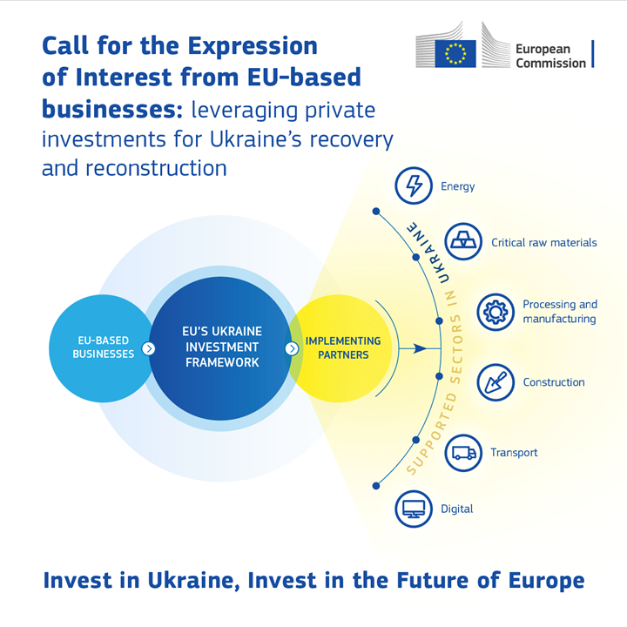

Slide 6
Call for Expression of Interest - Priority Areas
Based on the Ukraine Plan and Strategic Orientations of the UIF, outlining key real economy sectors requiring Foreign Direct Investment (FDI) including:
Energy
Critical Raw Materials
Processing industry and manufacturing:
Construction materials:
Information technology and digital transformation
Transport and export logistics

Slide 7
Call for Expression of Interest - Eligibility
Geographic Area – projects on the territory of Ukraine
Private Sector Entity
Nationality of Private Entity – companies possessing their real legal seat / legal incorporation in one of the EU Member States /EEA countries
Alignment with Policy Priorities
Minimum Investment Size – projects must meet a specified minimum investment threshold, including a total size of the investment project at EUR 50 million and an own equity participation by the project promoter at 10% of the total value of the investment project.

Slide 8
Call for Expression of Interest - Assessment
Strategic Criteria:
EU policy objectives and priority areas for investments in Ukraine.
Ownership of the company in view to support EU open strategic autonomy.
Compliance with EU standards and to the Do No Significant Harm Principle.
Impact Criteria:
Impact of the project proposal on supporting EU strategic interests,
Replicability and scalability of the project proposal.
Innovative features of the project proposal.
Capacity of the Participant to mobilise private capital
Market assessment and addressing of market failures.
Financial Criteria:
Financial viability, maturity and investment capacity

Slide 9
Call for Expression of Interest - Submission
Deadline: March 1st, 2025 00:00 – Brussels time.
Submission via an online form: EUSurvey – Survey
Supporting documents:
Two-page project fiche detailing the key elements of the project, including the scope, objectives, timeline, investment size, impact and expected outcomes, innovation aspects, maturity of the project, risk assessment and mitigation measures, financial structure of the project proposal, alignment with EU priorities;
Document presenting the governance and ownership structure of the company, including information on key shareholders, nationality of shareholders with ownership above 10%;
Declaration of honour on exclusion criteria and selection criteria

Slide 10
Call for Expression of Interest – Benefits
Feedback by COM on initial project submission
Advice on eligibility under existing EFI programs
Advice on doing business in Ukraine
Feedback for COM on demand > design of future calls
Visibility at upcoming COM events (if desired)

Slide 11
Interactive Q&A Session 10:40 – 11:00
In-person attendees: please raise your hand
Online attendees: please write your question in the chat
For written inquiries: NEAR-EU-UKRAINE-INVESTMENT-FRAMEWORK@ec.europa.eu

Slide 12
Relevant programmes under the Ukraine Investment Framework 11:00 – 11:30
Orest Tokač, Policy Officer, Ukraine Service, DG NEAR, European Commission

Slide 13
UKRAINE FACILITY
2024-2027
Pillar 1
Ukraine Plan - Support to state budget against conditionality EUR 38.3 bn
Pillar 2
Ukraine Investment Framework
EUR 9.3bn in guarantees and blending (6.97 bn provisioning & grants)
Pillar 3
Assistance programmes EUR 4.4 bn
Payments of grants and loans to Ukraine State budget based on agreed policy conditinality to:
- address the urgent financial needs of the State to maintain macro-financial stability
- encourage reforms needed for growth and EU accession
- promote investments for recovery, reconstruction and modernisation
Largest source of investment financing in Ukraine until 2027
De-risking mechanism available to investors through International Financial Institutions to scale up public and private investments and crowd in new investors
Support to the private sector, SMEs and start-ups
25% time-bound exclusivity period for EIB
Technical assistance to the Government (EU acquis, structural reforms)
Capacity building of the authorities at national, regional and local level
Support to civil society
Coverage of interest rate subsidies for loans

Slide 14
Ukraine Investment Framework – Targets
1
2
3
Target
≥20%
of the overall amount
(UIF and Ukraine Plan investments)
≥25%
of the Ukraine guarantee
≥15%
of the Ukraine guarantee
Description
climate change mitigation
environmental protection
biodiversity conservation
green transition
The EIB Group to invest by 2025
UA sovereign entities and non-commercial sub-sovereign entities
Start-ups
SMEs

Slide 15
Ukraine Investment Framework – basic information
Objective
1
Mobilise investments for the reconstruction and modernisation of Ukraine, which will be consistent with the Ukraine Plan and will contribute to its implementation.
Background
2
UIF builds on the experience of European Fund for Sustainable Development Plus (EFSD+) and the Neighbourhood Investment Platform (NIP).
Types of support
Combination of blending / grants / technical assistance for EUR 1.5 billion and guarantees with a guaranteed capacity of EUR 7.8 billion directed to both public (SOEs, municipalities) and private sectors (SMEs). Objective: EUR 40 billion investments through mobilization
3
Investments areas
4
Energy, access to finance, human capital, transport, agri-food, critical raw materials, digital transformation and green transition.
Implemen-tation
5
Indirect management by pillar-assessed entities, i.e. European Financial Institutions (EIB, KfW, AFD, BGK, etc.) and multilateral Financial Institutions (EBRD, WB, IFC etc.).

Slide 16
Ukraine Recovery Conference: €1.4 billion signed unlocking €6 billion in investments
# | Imple-menting partner | Proposal | Approved amount [EUR M]
 |  |  | Blending | Technical Assistance | Guarantee
1 | EBRD | Financial Inclusion | 30 | 7 | 140
2 | EBRD | Hi-Bar |  | 7.5 | 150
3 | EBRD | Resilience | 25 | 7.5 | 150
4 | EIB | EU4Business Guarantee Facility | 50
5 | EIB | EFSD+ MSME Access to green, growth and inclusive finance |  |  | 150
6 | EIB | Jaspers | 10
7 | BGK | EU Support for Ukrainian MSMEs | 20
8 | IFC | Better Future Programme |  | 17.5 | 350
9 | KfW | Green Growth Fund (GGF) | 50 | 5
10 | KfW | European Fund for Southeast Europe (EFSE) | 54 | 1
11 | KfW | Municipal Infrastructure Development (Chernivtsi) | 17.75 | 2.75
12 | KfW | Reconstruction and rehabilitation of the electricity transmission infrastructure | 100
TOTAL |  | TOTAL | 356.75 | 48.25 | 940
13 | EBRD | Ukraine Recovery and Reconstruction Guarantee Facility |  | 2 | 50
TOTAL with EBRD URGF |  | TOTAL with EBRD URGF | 356.75 | 50.25 | 990
Beneficiary entities
Private companies, incl. SMEs
Municipalities
UA state-owned enterprises
Targetted sectors
Repair, rehabilitation and development of energy infrastructure
Transport
Municipal sectors
Access to finance for SMEs
Businesses affected by the war in deoccupied and front-line zones
Will mobilise:
€ 6 bn
Overall sum
€ 407 M
€ 990 M
Blended finance grants
Guarantees

Slide 17
EU launches a call for proposals under the Ukraine Investment Framework to boost investments for Ukraine’s recovery
Types of calls launched in September
Key details
1
Call timeframe
Indicative amount
PUBLIC INVESTMENTS
Public sector operations, involving sovereign and non-commercial sub-sovereign entities, which are in line with public investment policy of Ukraine
12 months
EUR 2.75 billion
Investments areas
2
DIRECT PRIVATE INVESTMENTS
Private sector operations where
implementing partners enter in direct agreements with private and commercial sub-sovereign entities
access to finance,
human capital,
energy,
transport,
agri-food,
critical raw materials,
digital transformation
green transition.
3
Eligible entities
PRIVATE EQUITY INVESTMENT
Equity and quasi-equity for private projects intermediated via funds
Pillar-assessed entities such as:
the international and European multilateral financial institutions, incl: the EIB Group, EBRD, IFC, CEB, and
bilateral financial institutions such as development banks and export credit agencies.

Slide 18
Relevant programmes under the Ukraine Investment Framework 11:00 – 11:30
Lada Busevac, Head of Brussels Office, IFC – International Finance Corporation
Florence Bachelard-Bakal, Regional Head of Manufacturing and Services, EBRD – European Bank for Reconstruction and Development (online)
Guillaume Froment-Meurice, Senior Investment Officer - Corporate and Impact Finance Outside EU, EIB – European Investment Bank (online)
Karol Tofil, Head of International Relations, BGK Polish Development Bank (online)

Slide 19
Interactive Q&A Session 11:30– 11:50
In-person attendees: please raise your hand
Online attendees: please write your question in the chat
For written inquiries: NEAR-EU-UKRAINE-INVESTMENT-FRAMEWORK@ec.europa.eu

Slide 20
Next Steps, Milestones and Events 11:50 – 12:00
Elisabeth Szeli, Policy Officer, Ukraine Service, DG NEAR, European Commission

Slide 21
Event preview
EU-Ukraine Business Summit in Brussels, April 10-11
Two days of panels and workshops, in collaboration with Ukraine, Italy and Poland
Ukraine’s reconstruction in the context of European reindustrialization and strategic autonomy
Reforms that can unlock investment and improve the business environment
Access to finance for SMEs
How Commission, DFIs and member states can cooperate on war insurance and de-risking

Slide 22
Thank you for your attention!
Press release: https://neighbourhood-enlargement.ec.europa.eu/news/eu-launches-call-eu-business-invest-ukraines-recovery-and-reconstruction-2024-11-13_en
Publication & applications: https://neighbourhood-enlargement.ec.europa.eu/european-neighbourhood-policy/countries-region/ukraine/ukraine-investment-framework/publication-call-expressions-interest-eueea-based-businesses-invest-ukraine_en
Contact for inquiries regarding the Ukraine Investment Framework: NEAR-EU-UKRAINE-INVESTMENT-FRAMEWORK@ec.europa.eu

